Slide 1
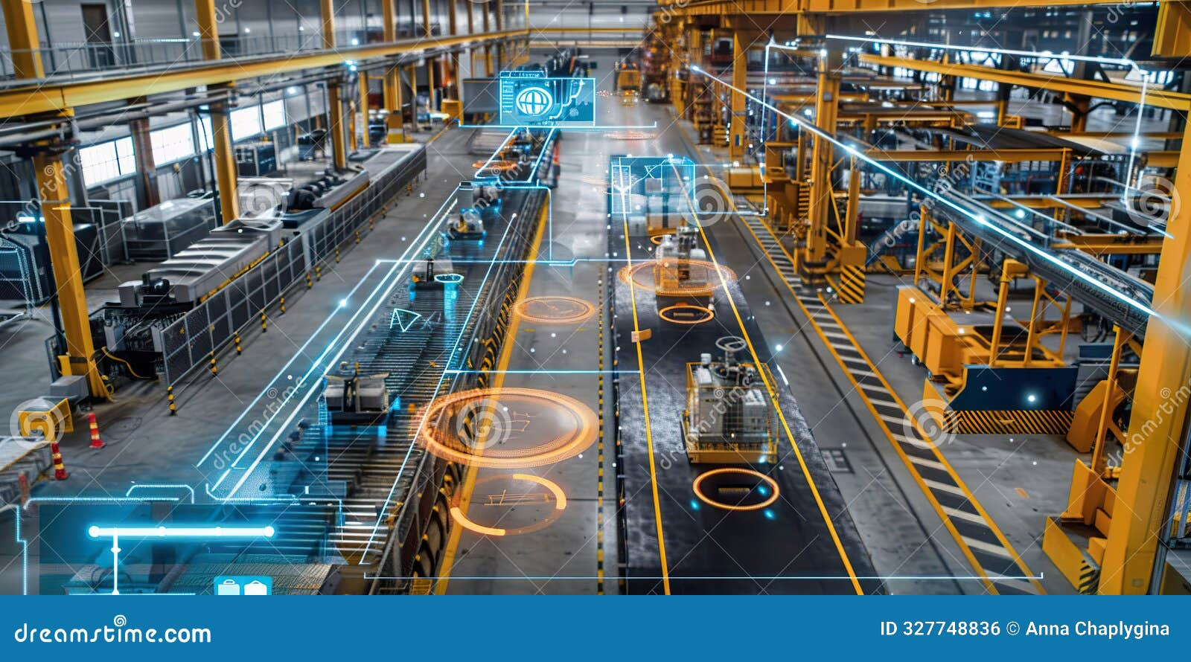
Project Aegis: Autonomous GenAI Agent for Industrial Predictive Maintenance
Integrating SLMs with Edge IIoT for Real-Time Factory Intelligence
Chad Jones | ITAI 3377 | Capstone Project

Slide 2

The Problem & The Vision
Current Issue: Most IIoT systems are "dumb." They send an alert only after a machine breaks, or when a sensor hits a simple threshold (e.g., Temp > 100°C).
The Vision: Create an autonomous agent that does not just read numbers, but understands machine behavior using Generative AI.
The Goal: Shift from Reactive Maintenance to Autonomous Reasoning. The system detects a subtle pattern, reasons through the cause, and schedules the fix without human input.

Slide 3

Project Scope & Objectives
Focus
CNC Milling Machines in a smart factory environment.
Key Deliverables:
Design an Edge-based architecture to minimize data latency.
Deploy a "Small Language Model" (SLM) capable of interpreting telemetry.
Automate the ticketing process via API integration.
Success Metric:
Reducing unplanned machine downtime by an estimated 25% through early-stage "reasoning."

Slide 4
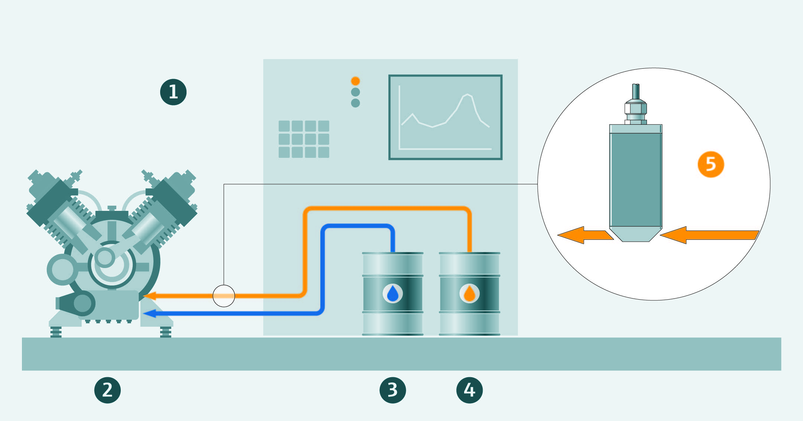
Conceptual System Architecture
Layer 1: Perception (Sensors): Vibration (Piezoelectric), Temperature (Thermocouples), and Acoustic sensors.
Layer 2: Edge Gateway: An industrial PC running a local MQTT Broker (Mosquitto). This acts as the "site brain."
Layer 3: The AI Agent: A quantized model (e.g., Phi-3) that processes JSON data packets from the sensors.
Layer 4: Action: Connection to the factory ERP system to generate work orders automatically.

Slide 5
Data Flows & Protocols (The Technicals)
Sensor
Protocol: MQTT (Message Queuing Telemetry Transport).
Why? Because it is lightweight and handles unstable factory Wi-Fi better than HTTP.
Payloads: Data is sent in JSON format.
The Loop: Sensor → Publisher → MQTT Broker → Subscriber (AI Agent) → Action Command.
Publisher
MQTT Broker
Suscriber (AI Agent)
Action Command

Slide 6
The AI Brain: Generative AI at the Edge
Model Selection: We are using Quantized SLMs (Small Language Models).
Why not ChatGPT? Cloud AI is too slow for real-time factory decisions and has privacy risks.
Reasoning Process: The model uses RAG (Retrieval-Augmented Generation).
It looks at sensor data + It "retrieves" the machine’s service manual from a local database.
It "generates" a diagnosis: "Vibration at 4kHz suggests a loose spindle bolt. Order a 10mm hex wrench for repair."

Slide 7


Security & Privacy Measures
Encryption: Using TLS 1.3 for all MQTT traffic to prevent "man-in-the-middle" attacks.
Device Authentication: Each sensor must have a unique X.509 Certificate to talk to the gateway.
Local Processing: Since the GenAI runs locally (on-premise), sensitive factory data never leaves the building. This eliminates "Data Leakage" risks common with public AI.

Slide 8
Theoretical Testing Strategy
Phase 1: Latency Stress Test:
Simulate 500 sensors firing at once. Measure if the Edge Agent can process all data in <1 second.
Phase 2: Accuracy "Sandbox":
Feed the AI "historical failure data" to see if it correctly identifies a breakdown before it happens.
Phase 3: The "Kill Switch" Test:
Ensure the autonomous agent cannot override critical safety protocols (e.g., if the AI suggests "keep running," but the hardware temp sensor hits a hard limit, the machine must shut down).

Slide 9
Challenges & Trade-offs
Compute Limitations: Running GenAI on a small Edge box is hard. We have to balance model "intelligence" vs. "speed."
Hallucinations: GenAI can be over-confident.
Solution: We implement a "Confidence Score." If the AI is less than 85% sure, it must ask a human engineer before taking action.
Initial Cost: Industrial Edge hardware is more expensive than standard cloud-only setups.

Slide 10
Conclusion & Future Work
Summary: Project Aegis shows that GenAI is not just for chatbots; it is a tool for industrial autonomy.
Future Scalability:
Expand to "Fleet Management" where one AI agent monitors 100+ machines.
Integrate "Vision AI" so the agent can "see" smoke or leaks via cameras.
Closing: Moving intelligence to the Edge is the only way to achieve true "Industry 4.0."

